Slide 1
What defines success of a project on Kickstarter?
By Academic Group 02

Slide 2

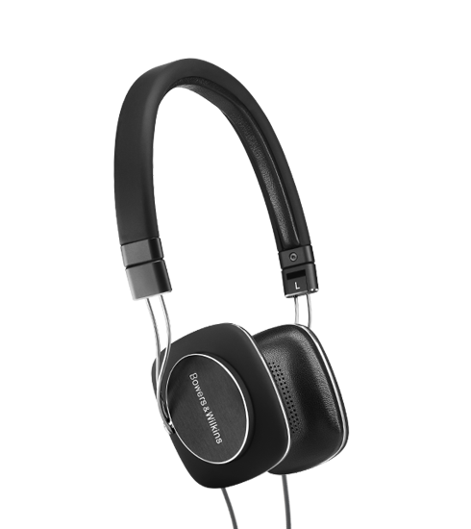
ध्वनिविस्तारक यंत्र
The Headphone Story

Slide 3
Kickstarter

Slide 4


Slide 5
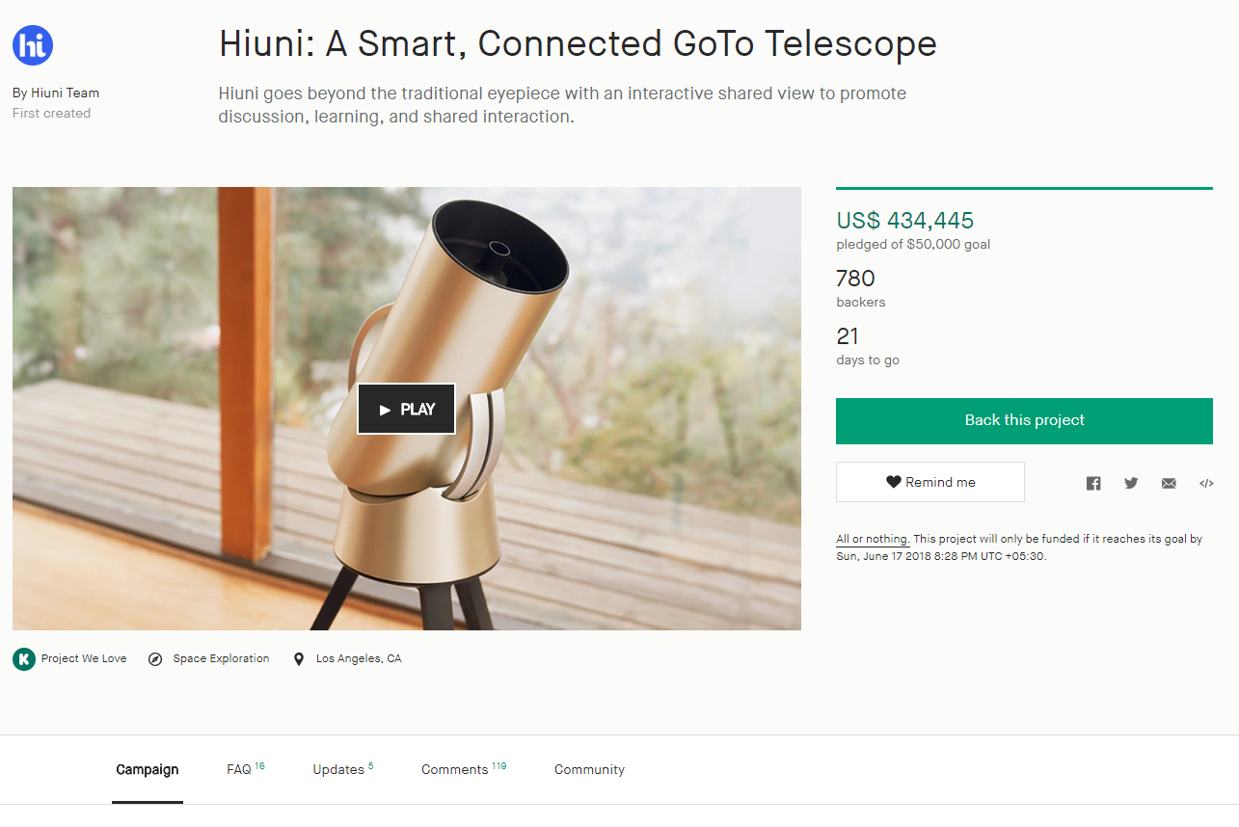


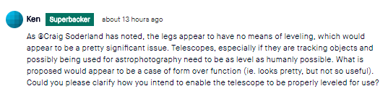
Kickstarter Project Page
Updates
Rewards
Comments

Slide 6
Some Statistics on Projects
Total Dollars pledged to Kickstarter project $3.7 Billion
Successfully funded projects 1.44 Lakhs
Total backers 14.6 million
36%
64%
Repeat backers 4.7 million
Total pledges 45.8 million

Slide 7
Location influence
`
`
35 %
32 %
45 %
33 %

Slide 8
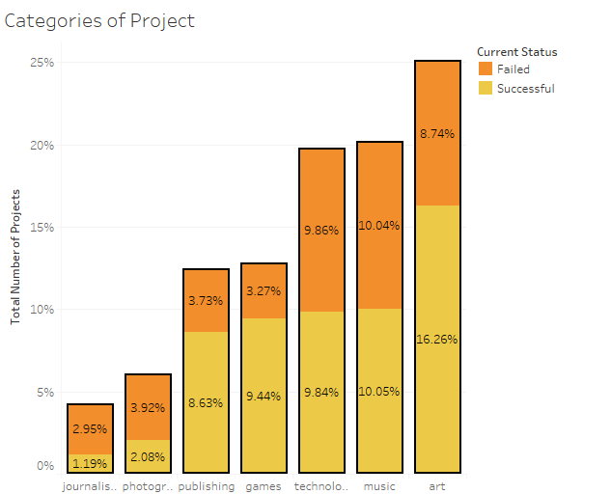
Category Wise Analysis

Slide 9
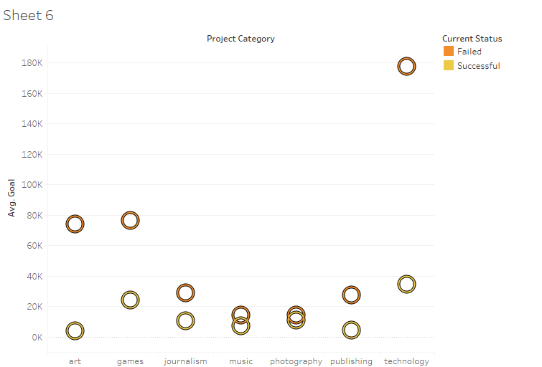
Category and Amount Pledged

Slide 10

AFTER A MONTH!

Slide 11
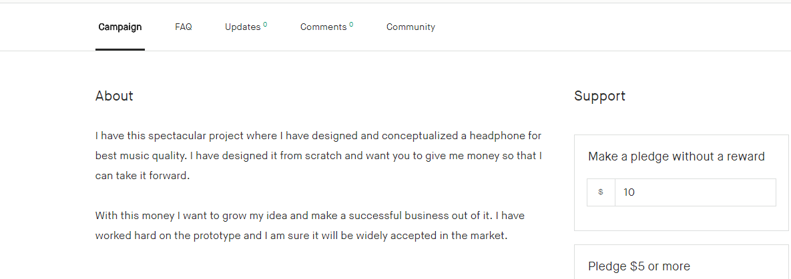

Slide 12



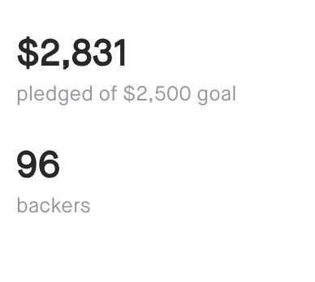
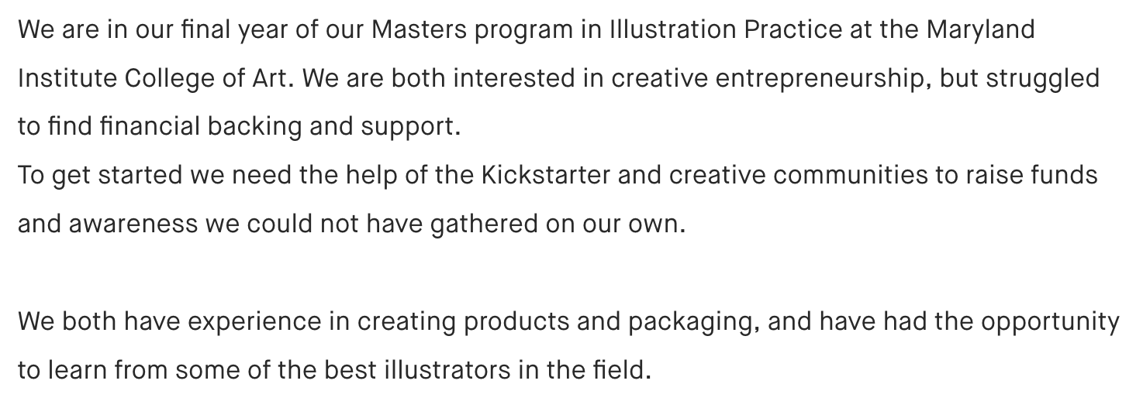
Credibility of the Creator

Slide 13



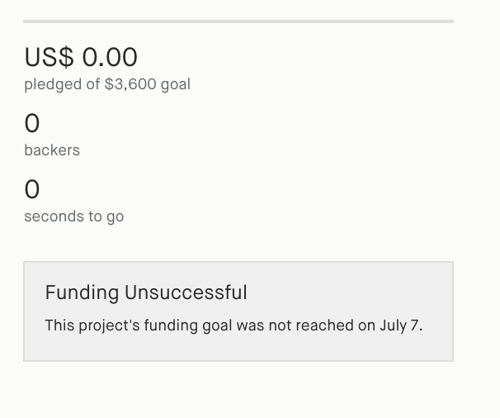
Collective Phrasing

Slide 14


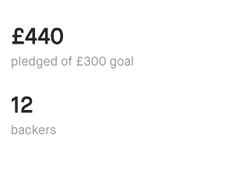
Collective Phrasing

Slide 15
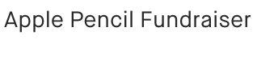
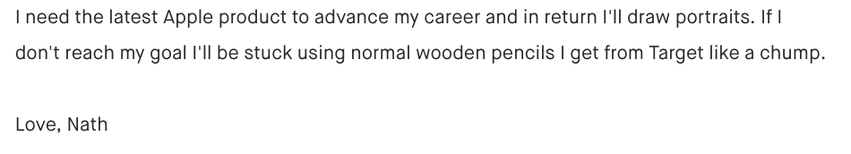
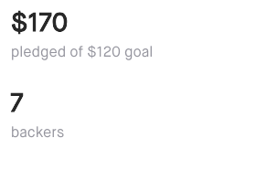
Reciprocity

Slide 16
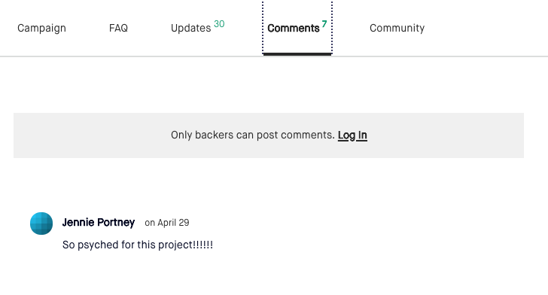

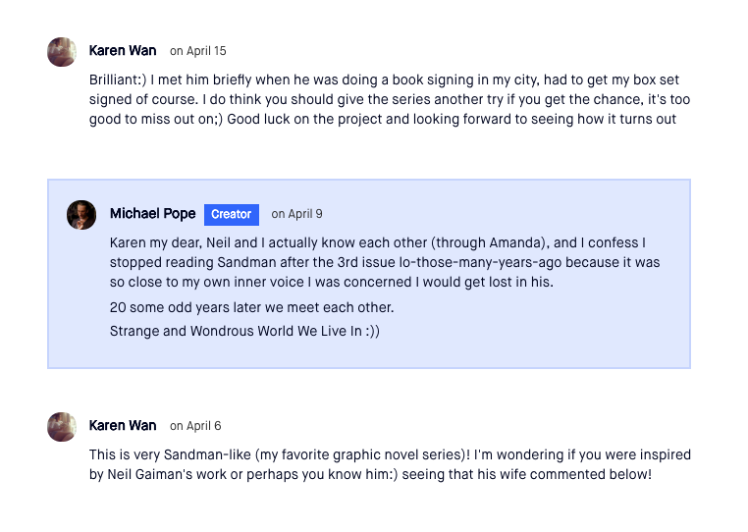
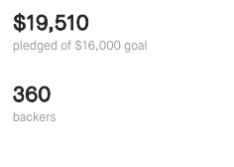
Comments Sentiment

Slide 17
Other Important Aspects
USA
18
14
Staff Pick
Country
Words in Blurb
No of Rewards per Goal
Staff Choice

Slide 18
?
Missing: Clout, giving back to pledger

Slide 19

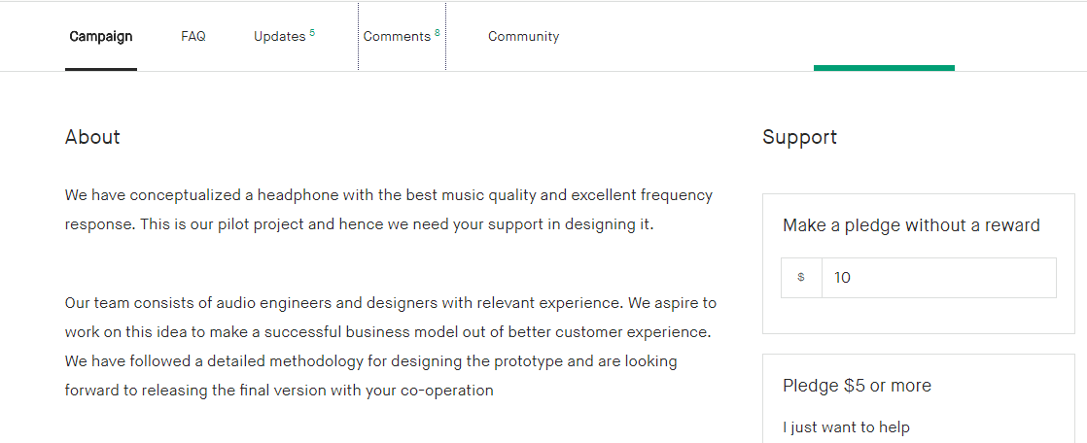

Slide 20
Approach
DATA SOURCES
PRE PROCESSING
Data Cleaning
Online Dataset
Data Integration
Scrapping
Data Transformation

Slide 21
Approach
Quantitative
Features
Random forest Classification
72% Accuracy
Description/ Comments
Psycholinguistic/
Sentiment Analysis

Slide 22
Most Important Features
Reward per average goal
Category
Blurb
Length
Comments
Description
Tone
Number of rewards

Slide 23



Slide 24
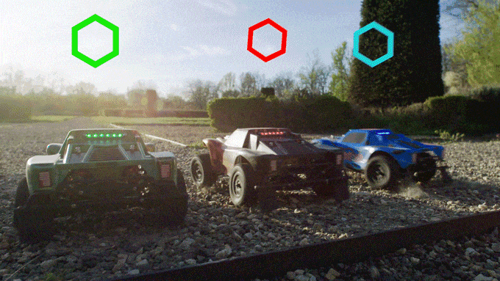

Slide 25
Recommendations
To increase the success rate of projects on the platform Kickstarter should ensure the following:
Project description needs to be Crisp : Ideal length : 18 words
Increase the Reward levels: Ideal reward level : 14
Create a Buzz: Engage the backers in comments section

Slide 26
Recommendations
Prepare your speech well. Description suggestions:
Avoid use of I & increase the usage of we and you
Convey the user benefits
Show social connections
Depict the credibility of creator
Kickstarter should include these guidelines as a part of their web application. It can leverage NLP to ensure that minimum requirements are met.

Slide 27
Thanks!
Any questions ?

